Slide 2
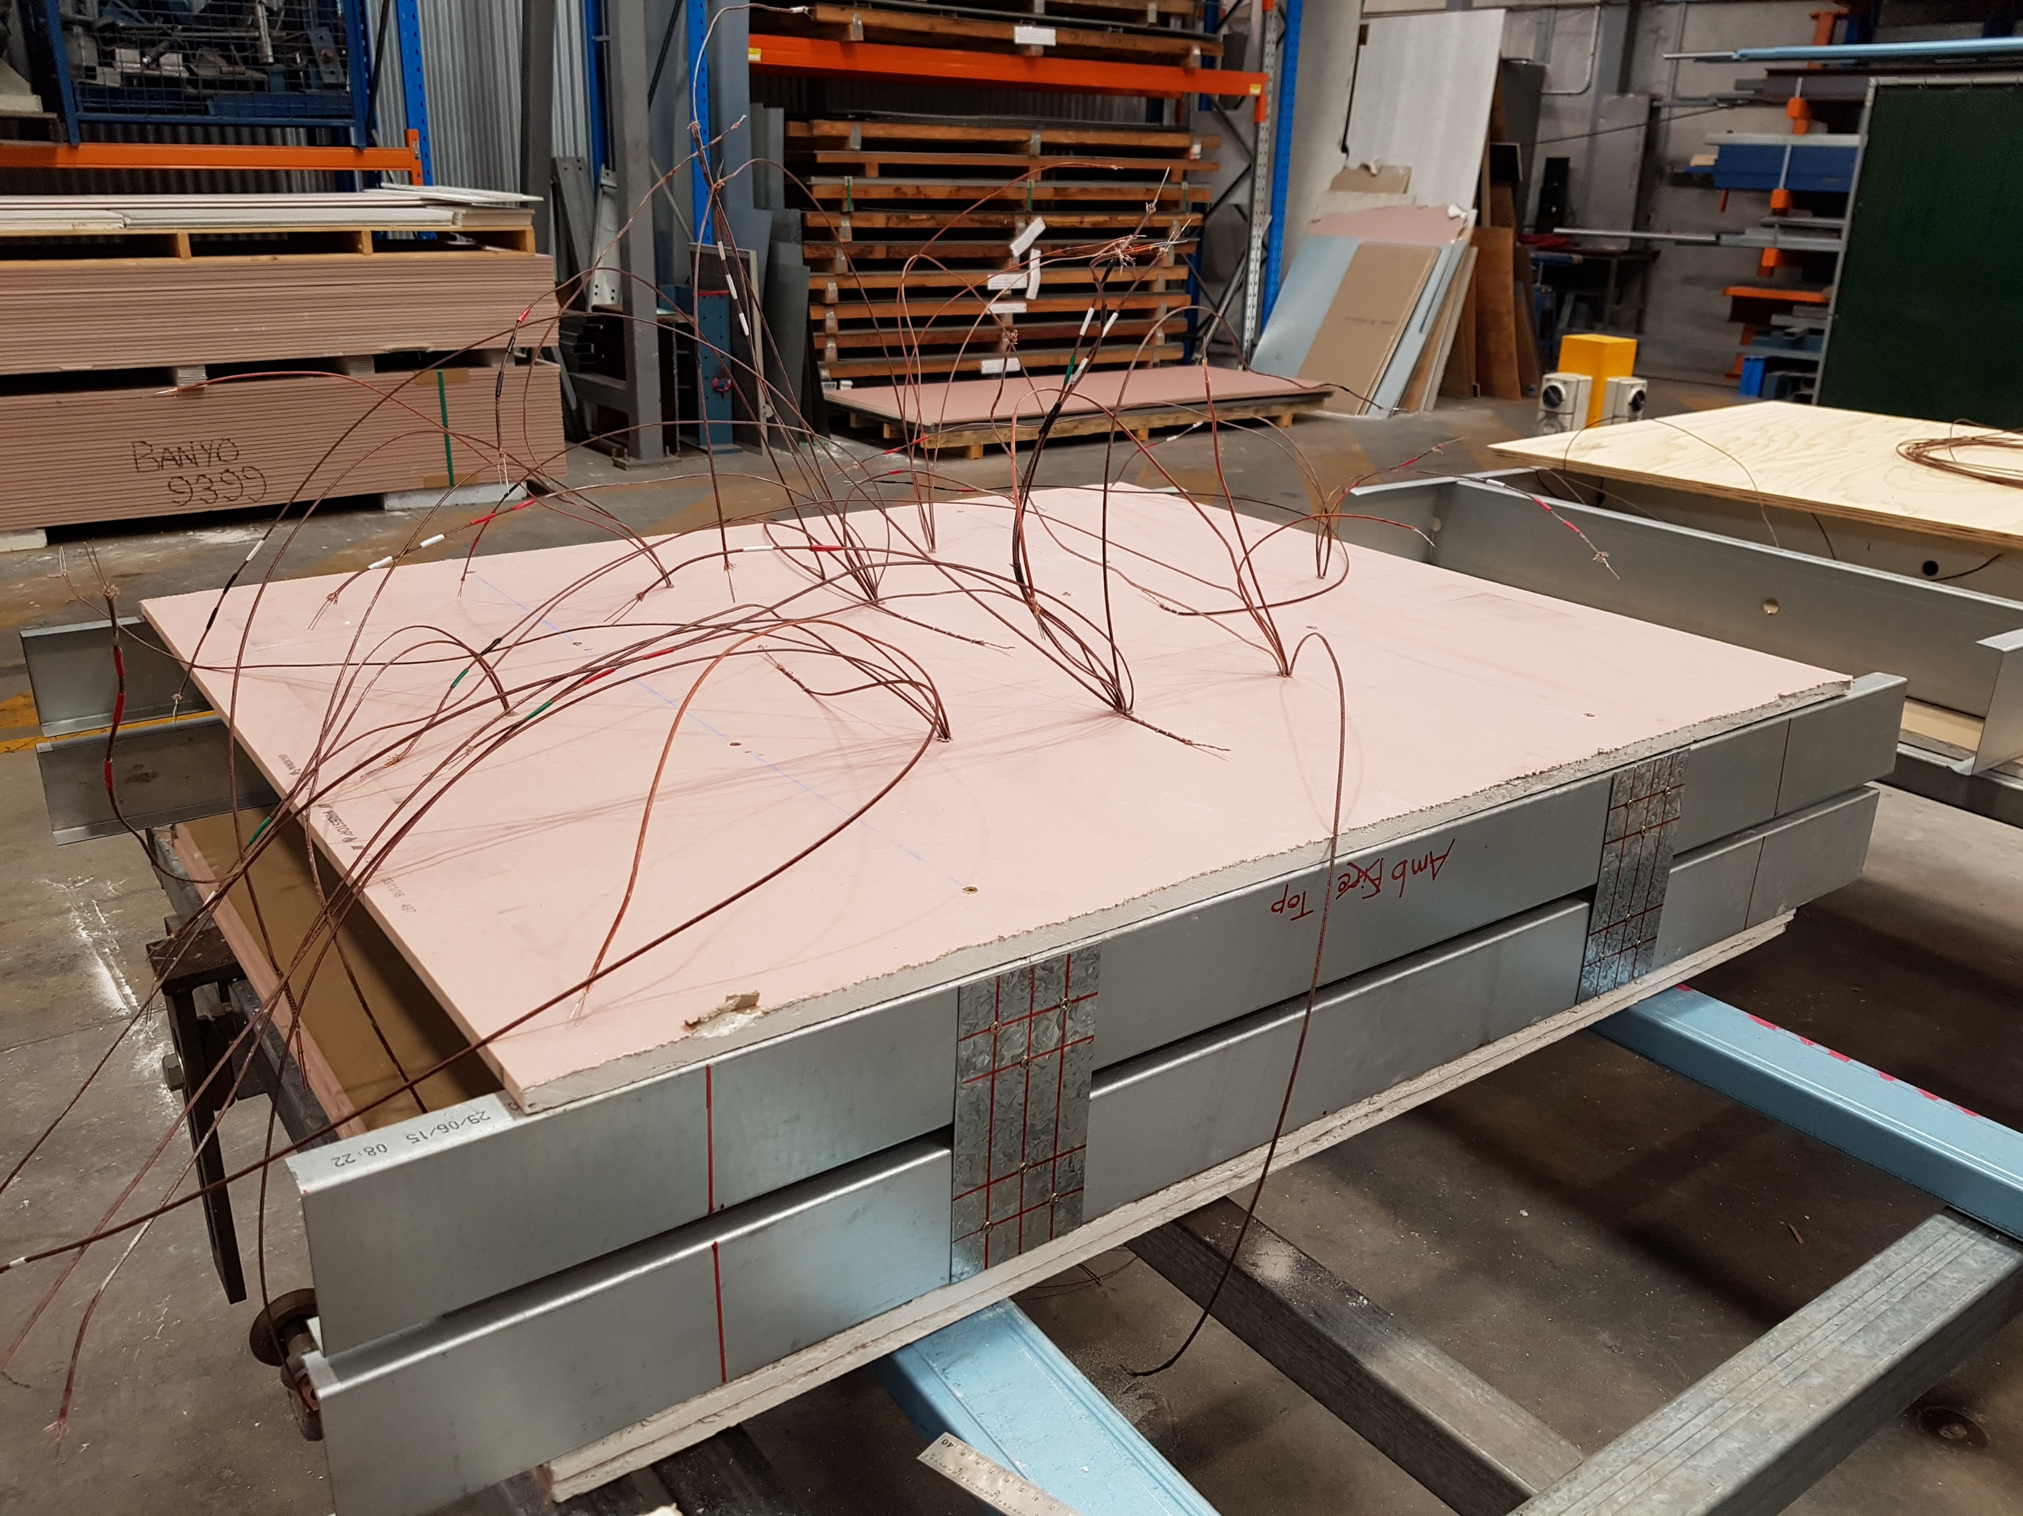
Thermocouples
Plasterboard
Tracks
Tracks
Spacer Plates at Stud Locations
Notes:
Small-scale - construction

Slide 3
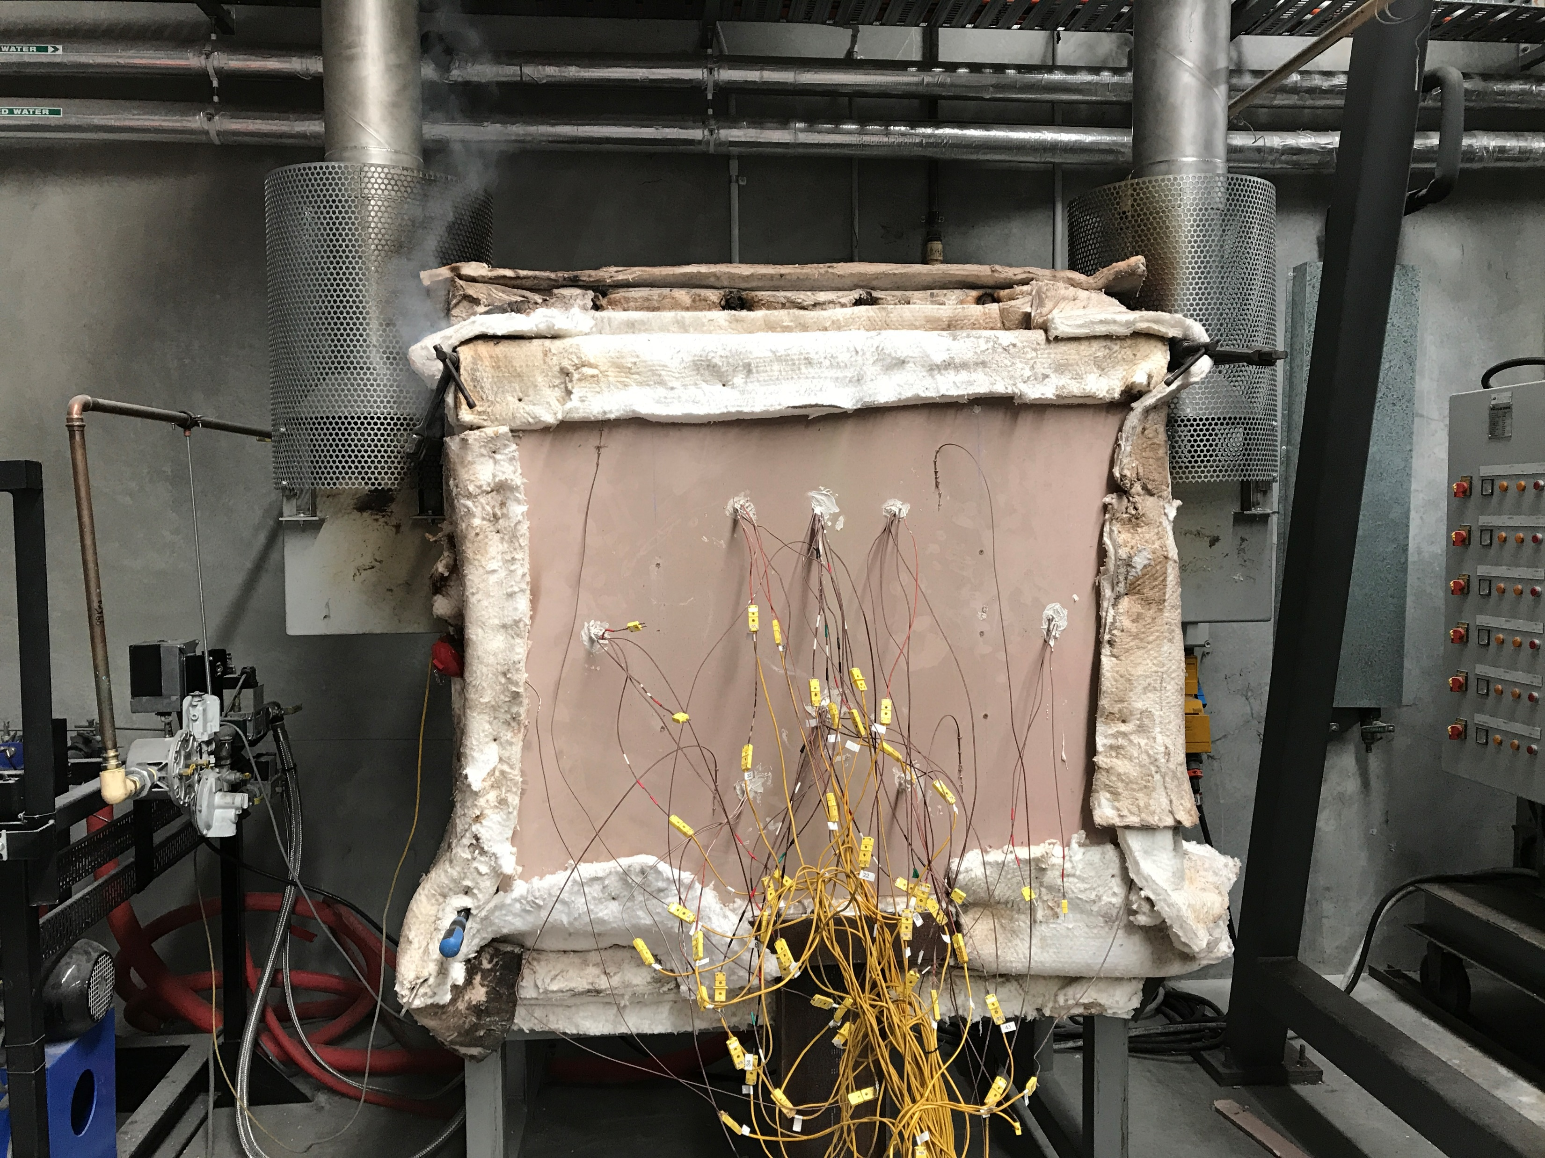
Exhaust
1 m
Supporting Clamps
1 m
Ambient Plasterboard
Thermocouples
Furnace Controller
Notes:
Small-scale – set-up

Slide 4
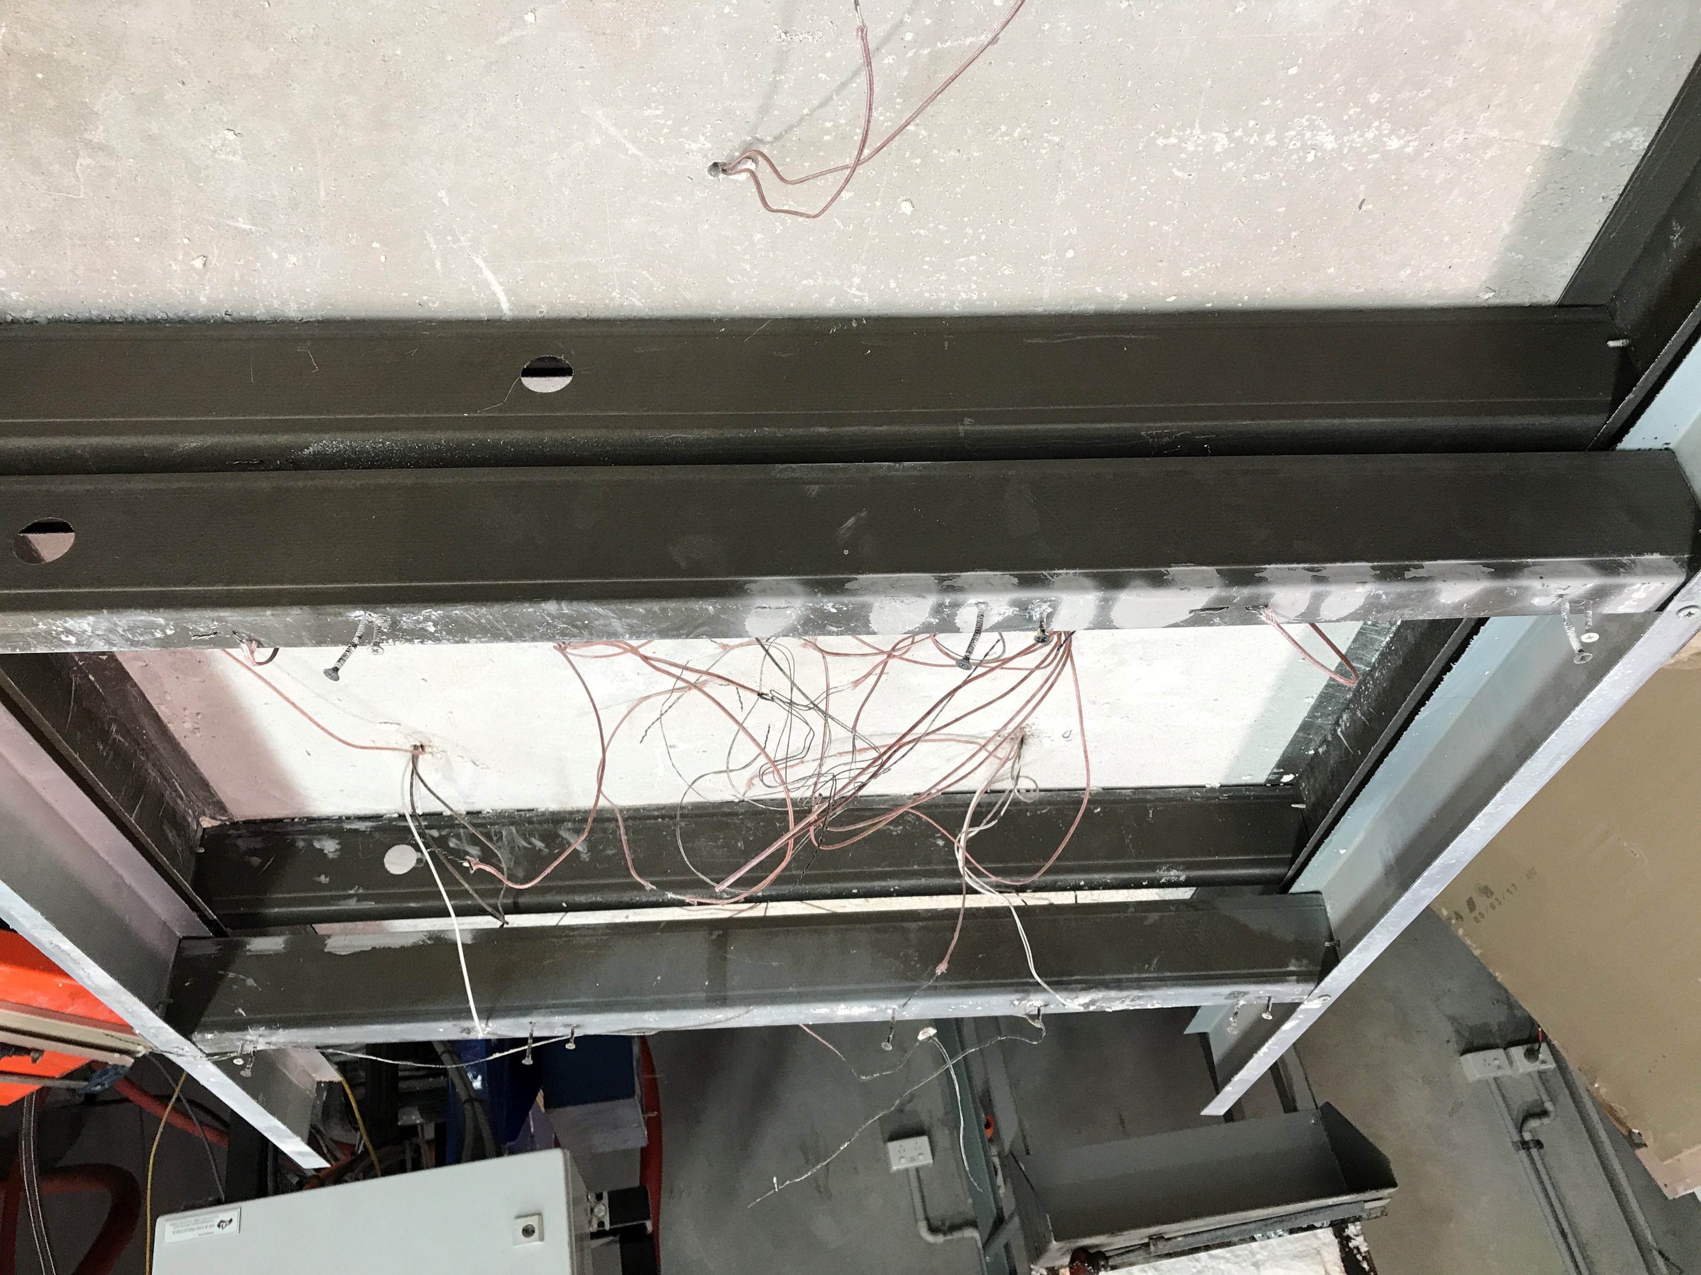
Studs After Fire Test
FHF
FCF
AHF
ACF
Notes:
Small scale – post testing

Slide 5
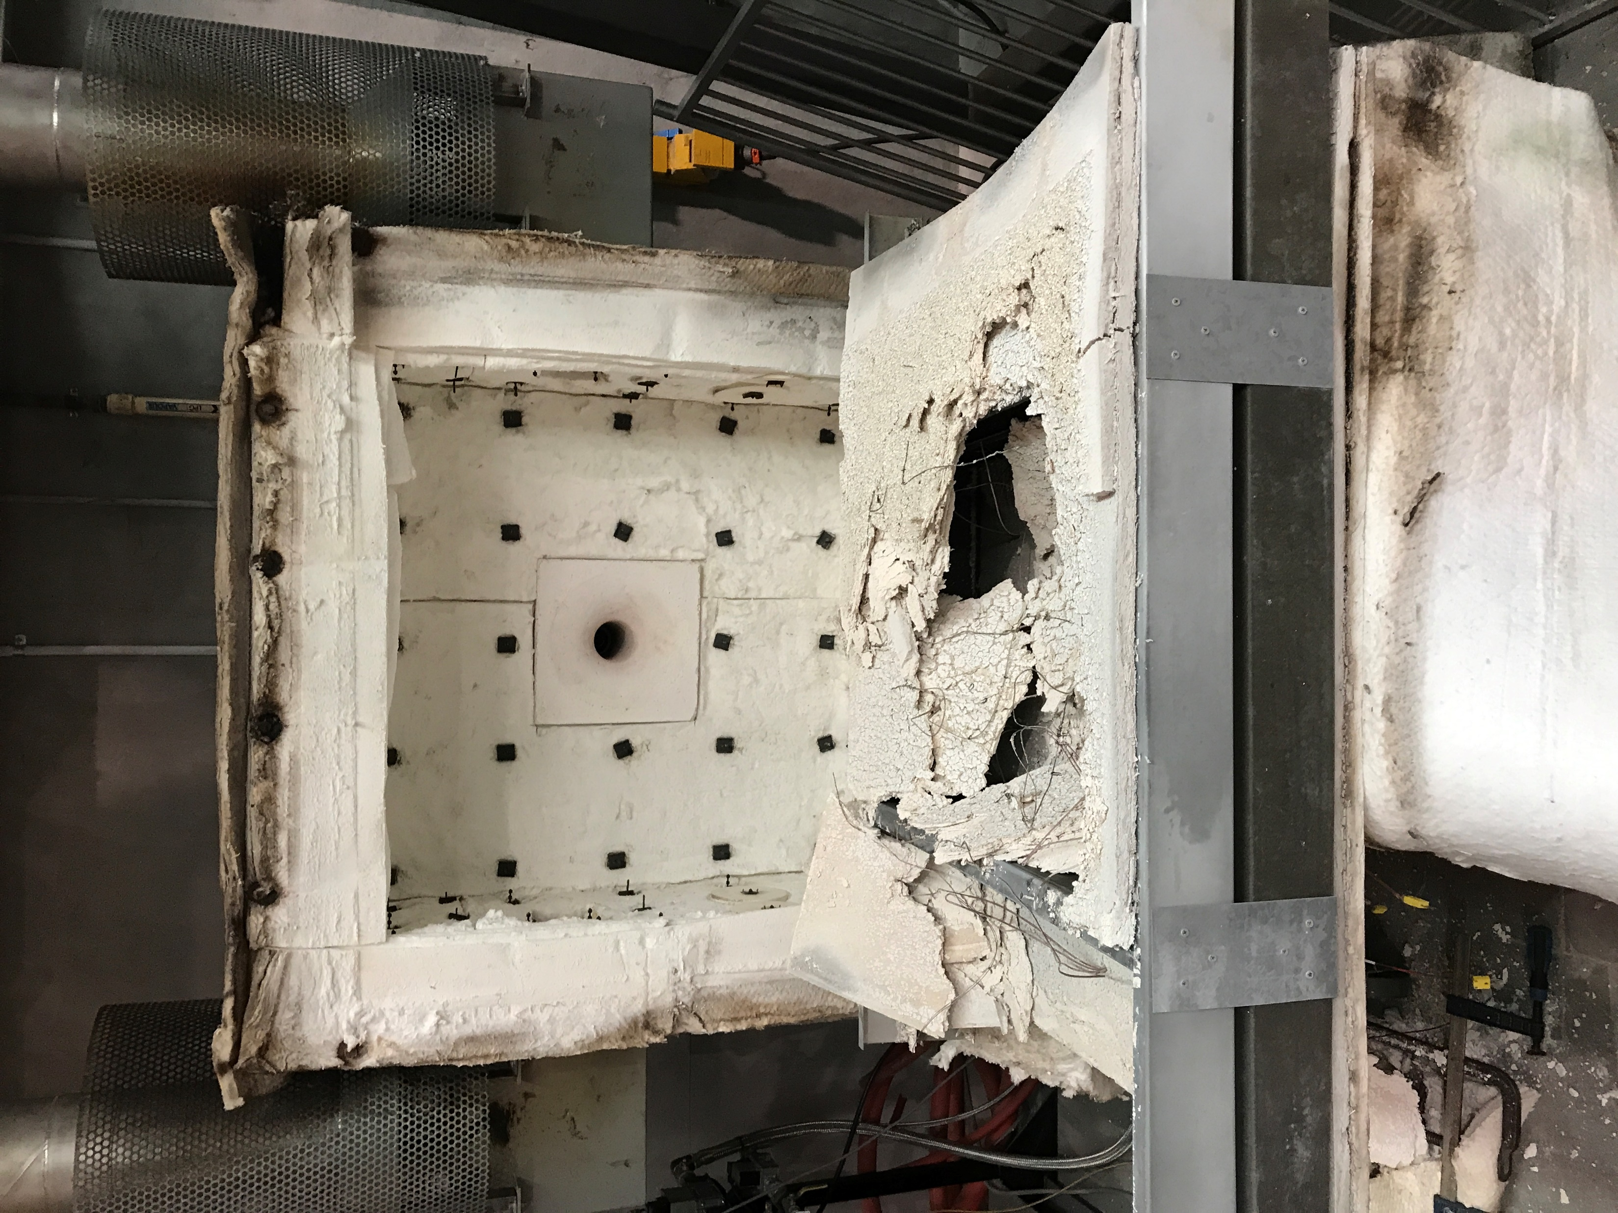
Fire Side
Plasterboard
Fall-Off
Furnace
Burner

